Slide 1
DATA ANALYSIS OF CARDIOVASCULAR DISEASE
CREATED BY:
RAM KHARAWALA
MOHIT BHASIN
DANIEL DIAZ
WEN ZHANG

Slide 2
INTRODUCTION – Reason for selecting the dataset
10 Biggest “killers” in terms of medicine in US
Data mining = Process of discovery of interesting, meaningful and actionable patterns hidden in large amounts of data

Slide 3
INTRODUCTION – Goals and Background
Dataset Used
We have used the Cleveland dataset for heart disease dataset from UCI repository
Creator of the Dataset
V.A. Medical Center, Long Beach and Cleveland Clinic Foundation: Robert Detrano, M.D., Ph.D
Goals of the project
Provide an overview and comparison of the algorithms that are relevant to the development and deployment of data mining solutions in medical datasets
Implement various algorithms on the data to help derive conclusion on classification and clustering of data
Analyze data in such a way to classify or predict a certain result which can be helpful in field of medical science
https://archive.ics.uci.edu/ml/datasets/Heart+Disease

Slide 4
INTRODUCTION – Algorithms Used
Classification
K-Nearest Neighbors
Clustering
Kmeans Clustering
Decision Tree - CART
Naïve Bayes

Slide 5
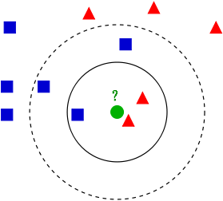
K-Nearest Neighbor - Goal
K-NN uses distance function to calculate the distance between points from the center
Our goal is to classify which age group is more prone to heart disease. The comparisons used to classify this are as follows
Age group vs Blood Pressure
Age group vs Cholesterol level
Age group vs Max heart rate achieved
Age group vs ST depression rate
Age group vs Chest pain type (table)
Age group vs Heart Narrowing

Slide 6
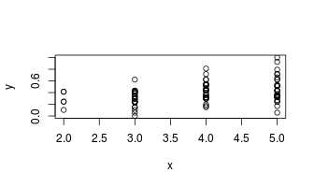
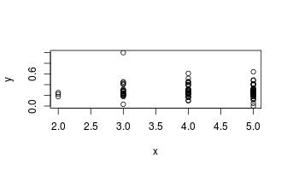
K-Nearest Neighbor – Intermediate conclusions
Age group vs Blood Pressure
Conclusion 1: Blood pressure level is high between the age 50 to 60 years
Age group vs Cholesterol level
Conclusion 2: Cholesterol level high between the age 40 to 60 years

Slide 7
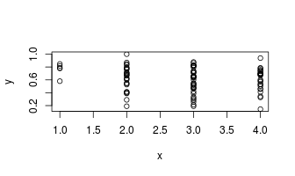
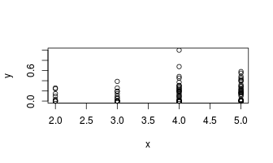
K-Nearest Neighbor – Intermediate conclusions
Age group vs Max heart rate achieved
Conclusion 3: Higher heart rate between the ages 30 to 40 years
Age group vs ST depression rate
Conclusion 4: Higher ST depression rate is found between the ages 50 to 60 years

Slide 8
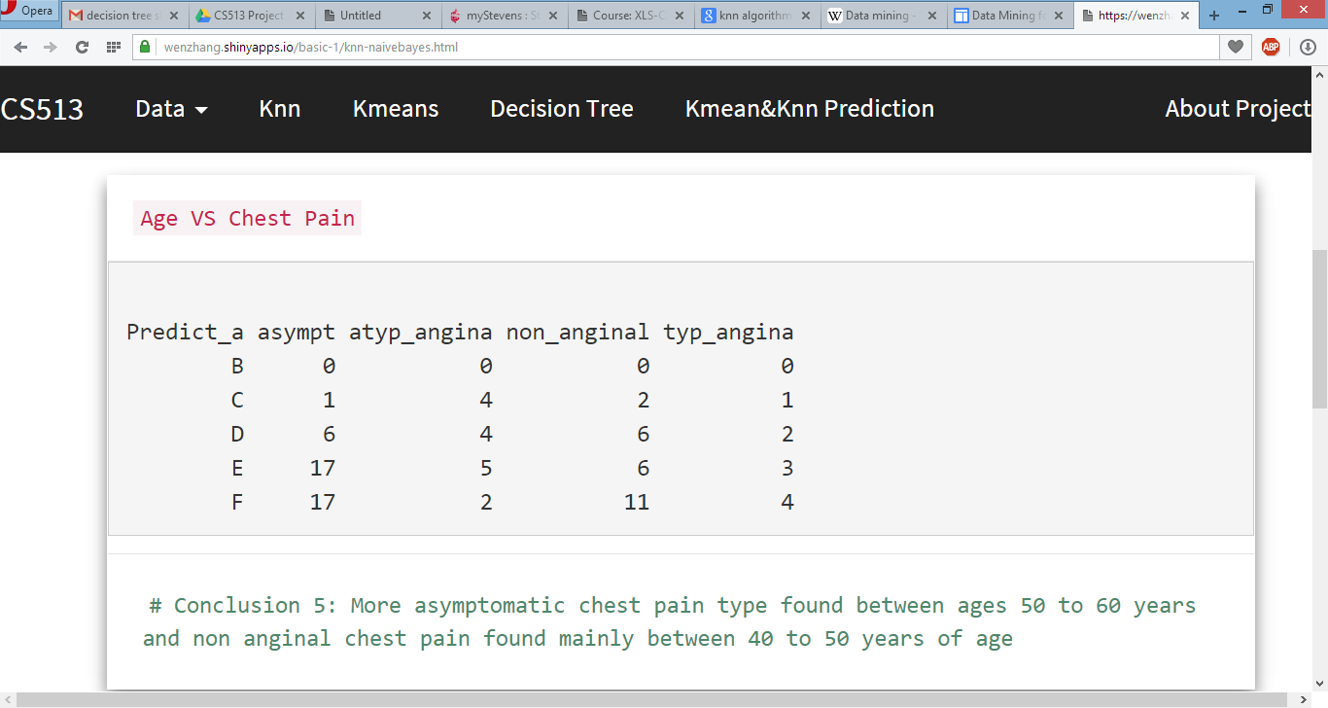
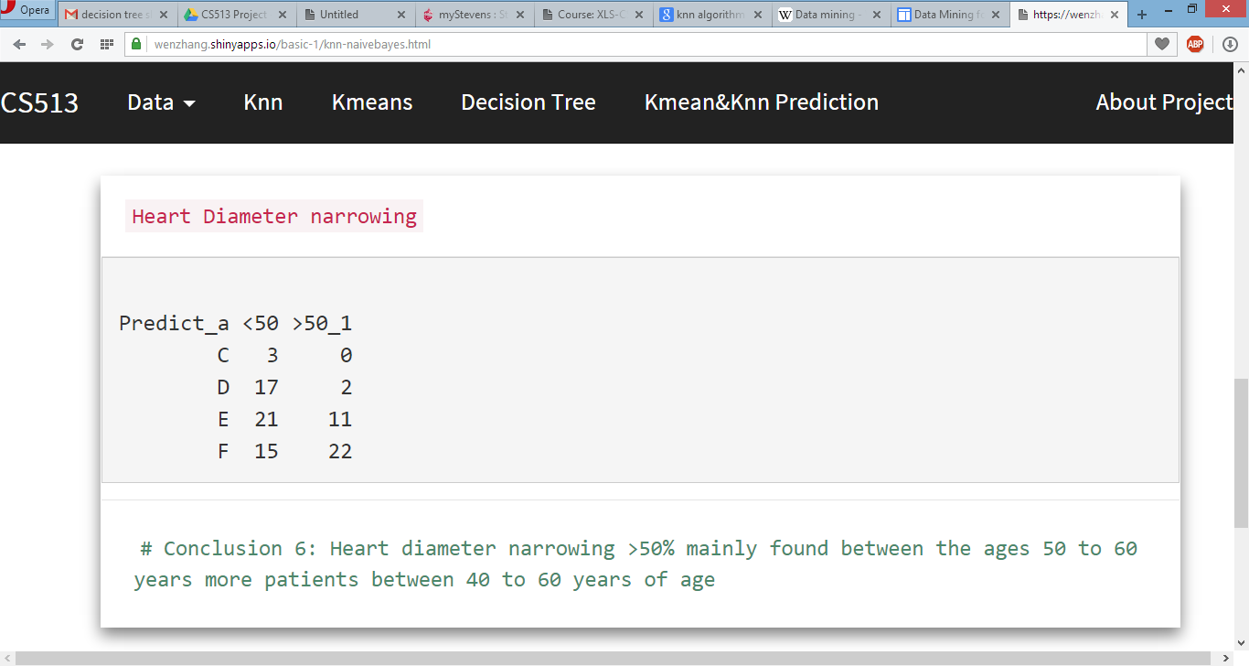
K-Nearest Neighbor – Intermediate conclusions
Age group vs Chest pain type (table)
Conclusion 5: More asymptomatic chest pain type found between ages 50 to 60 years and non angina chest pain found mainly between 40 to 50 years of age
Age group vs Heart Narrowing (table)
Conclusion 6: Heart diameter narrowing >50% mainly found between the ages 50 to 60 years more patients between 40 to 60 years of age

Slide 9
K-Nearest Neighbor – Conclusions and Error Rate
Conclusion 1 & 2
Conclusion 3 & 4
Conclusion 5 & 6
FINAL CONCLUSION: Patients more prone to cardiovascular problems are between the ages 40 to 60 years. Patients more prone to heart attacks are between the ages 50 to 60 years
The error rate changes everytime since the Training and Test dataset are not static.
The average accuracy rate achieved = 76.3%

Slide 10
Naïve Bayes
The Naïve Bayes Algorithm is a classification algorithm that is very similar to k-NN algorithm.
The difference is that Naïve Bayes works on Probability instead of distance function
Chest pain type
Gender
 | asymptomatic | atyp_angina | non_anginal | typ_angina
<50% | 23.63% | 24.84% | 41.81% | 9.69%
>50% | 75.36% | 6.52% | 13.04% | 50.72%
 | Female | Male
<50% | 43.63% | 56.36%
>50% | 17.39% | 82.60%
ECG Reading
Fasting Blood Sugar >120
 | Left vent hyper | Normal | ST wave abnormal
<50% | 41.21% | 58.18% | 0.6%
>50% | 57.24% | 40.57% | 2.17%
 | False | True
<50% | 86.06% | 13.93%
>50% | 84.05% | 15.94%

Slide 11
K-Means CLUSTERING
Clustering the data in the Dataset

Slide 12
K-means Clustering
k-means clustering is a method of vector quantization, originally from signal processing, that is popular for cluster analysis in data mining. k-means clustering aims to partition n observations into k clusters in which each observation belongs to the cluster with the nearest mean, serving as a prototype of the cluster.
You can say this “unsupervised classification”
Intuitively, if you would want to assign same label to a data points that are “close” to each other

Slide 13
K-Means: Algorithm
For a given cluster assignment C of the data points, compute the cluster means m_{k}:
For a current set of cluster means, assign each observation as:
Iterate above two steps until convergence

Slide 14
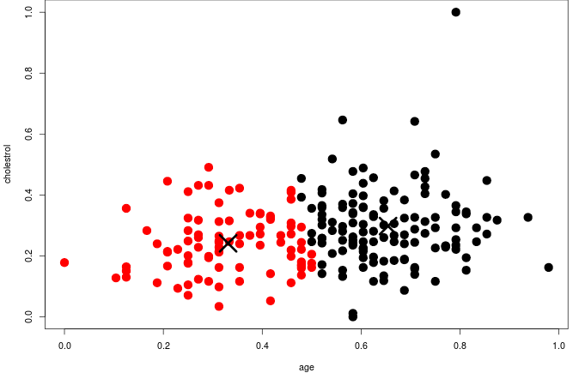
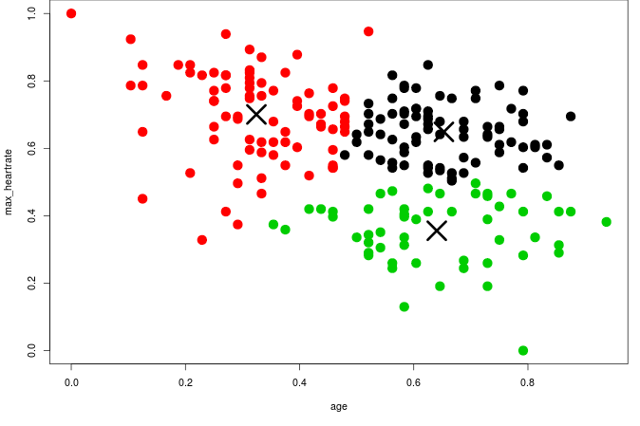
K-means Clustering on Shiny

Slide 15
USING DECISION TREE
Analysis of the dataset using Decision Tree

Slide 16
DECISION TREE: Splitting Criteria
Entropy:
E(S) = -(p+) log2(p+) – (p-)log2(p-)
E(S) = 0 means no impurity
All No’s (no disease) or all Yes’s (disease)
Select node with lowest entropy

Slide 17
DECISION TREE: Information Gain
Reduction in entropy from partitioning instances by attribute
=E(S) – sum ( S set A)/ (S) * E(S)
Choose nodes with largest information gain
Continue recursively

Slide 18
DECISION TREE: Missing Values (K-NN imputation)
5 missing values (NA) in column: vessel_color_flourosopy
Replaced with knn majority vote (0,1,2,3)
Classified based on contraction of heart arteries
>= 50 % disease , else no disease

Slide 19
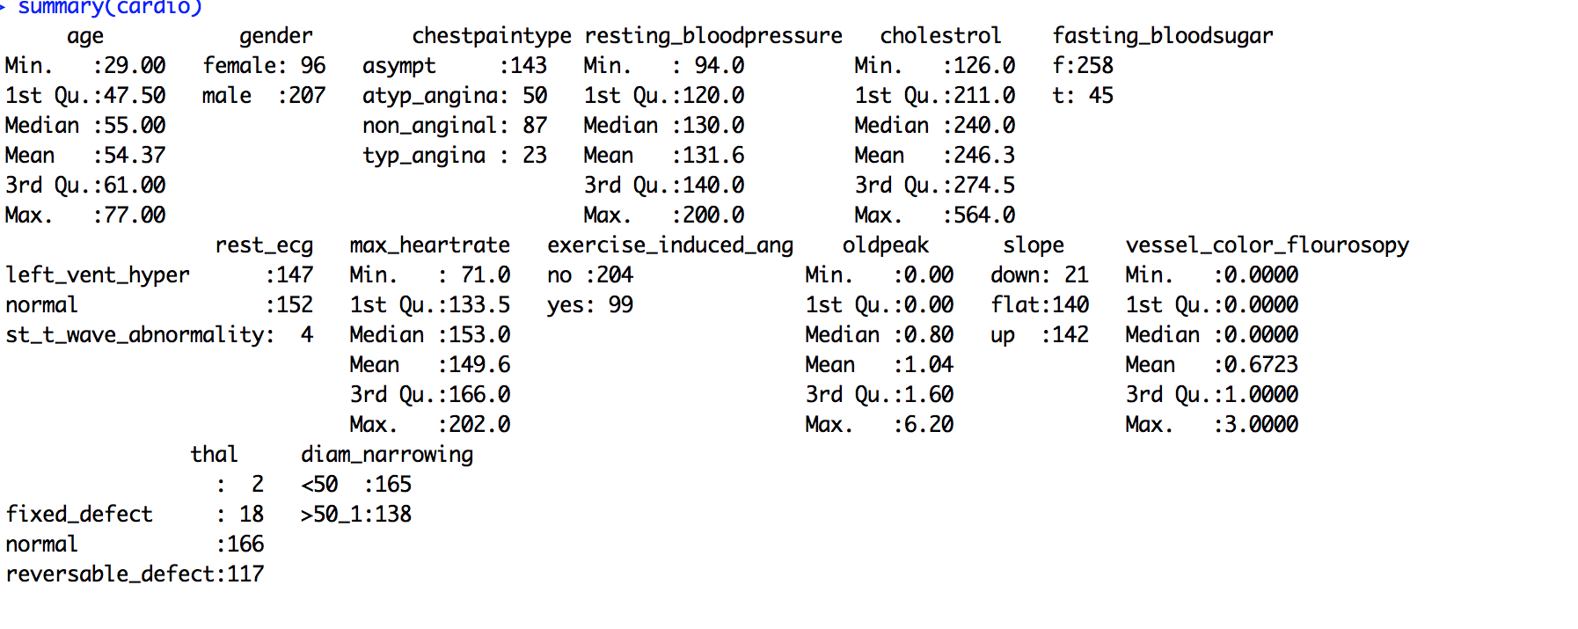
DECISION TREE: Data

Slide 20
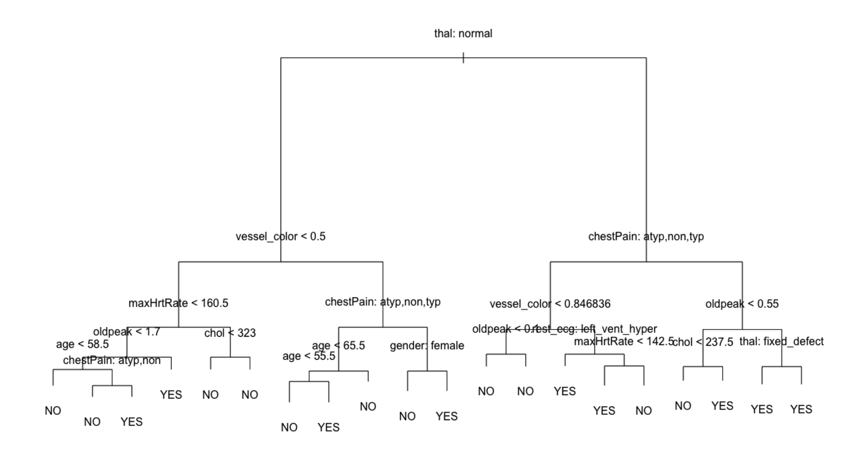
DECISION TREE: Initial Tree

Slide 21
DECISION TREE: Results
Tree has 20 leaf nodes
Need to Prune tree ( overfitting)
Separate Training set and testing set
Perform cross validation

Slide 22
DECISION TREE: Results (contd…)
Using previous tree obtained
Test error using test dataset (151 instances)
Accuracy rate (71+43)/151 = .7549

Slide 23
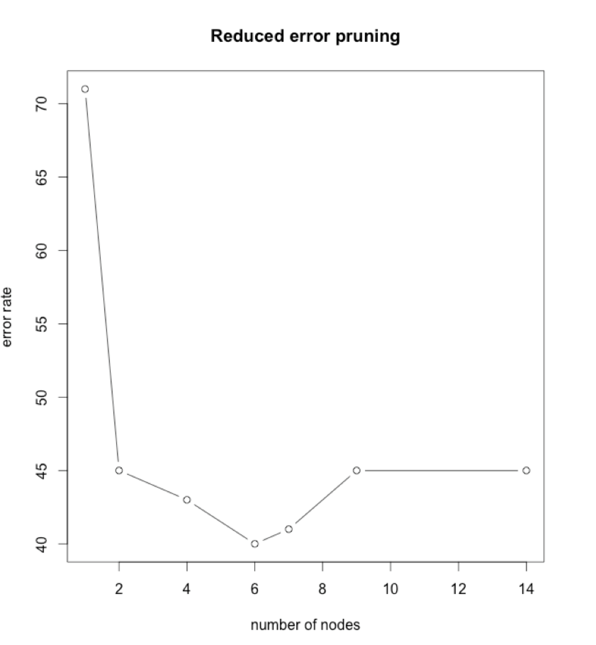
DECISION TREE: Cross Validation to find Optimal Pruning Level

Slide 24
DECISION TREE: Results after pruning
Optimal tree (least error)
6 terminal nodes
Accuracy ( on test) :
= 120/151 = .794
4% improvement pruning tree down to 6 leaf nodes

Slide 25
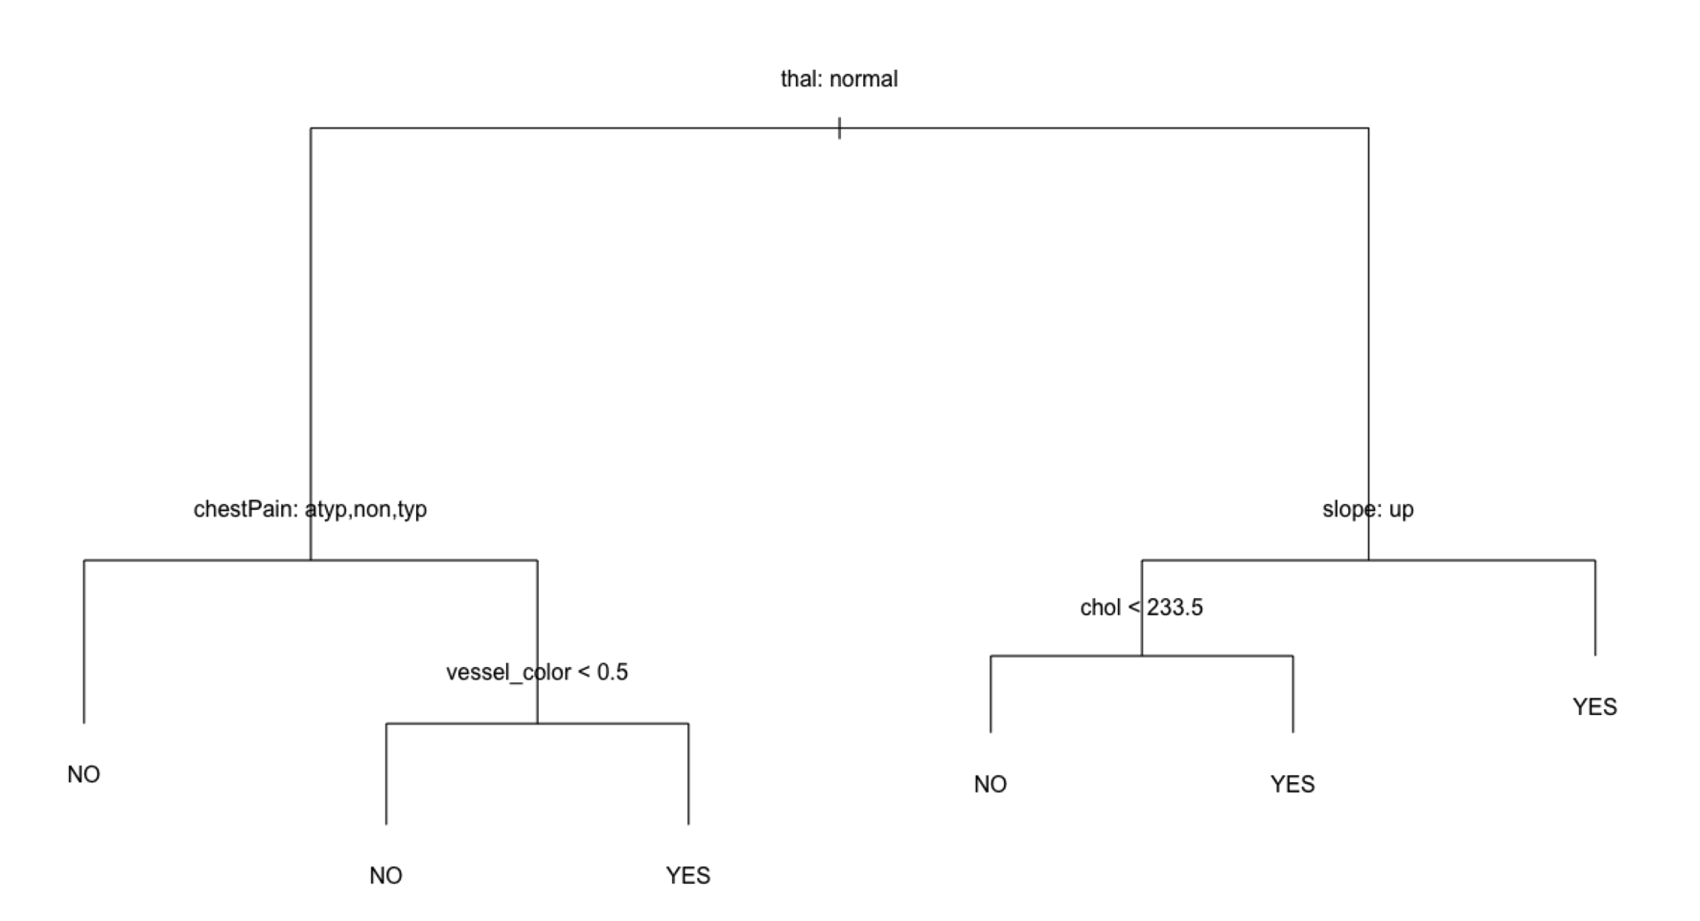
DECISION TREE: Optimal Tree

Slide 26
DECISION TREE: Classifying Heart Disease
Most important decision nodes (5)
Thalassemia: improper oxygen transport
Chest pain ( severity)
Slope up (slope at peak exercise)
# Vessels colored by fluoroscopy
Cholesterol level

Slide 27
COMPARISON OF ALGORITHMS: Accuracy

Slide 28
USING SHINY
Analysis of the dataset using Decision Tree

Slide 29
SHINY: What is it?
Shiny developed and Managed by RStudio.
A web application framework for R.
Turn your analyses into interactive web applications.
No HTML
CSS
JavaScript

Slide 30
SHINY: Basic Structure
Server Structrure
-----Root
-----------ShinyApp1
-----------ShinyApp2
Shiny App
-----Root
-----------ui.R
-----------server.R
Shiny App
-----Root
-----------Server.R
-----------www
------------------JS
------------------CSS
------------------index.html
------------------Other html Resource

Slide 31
SHINY: Reactivity
When an input changes, the server will rebuild each output that depends on it (even if the dependence is indirect). You can control this behavior by shaping the chain of dependence
Render
An output will automatically update whenever an input in its render* function changes.
Reactive expression
Use reactive to create objects that will be used in multiple outputs.
Isolate
Use isolate to use an input without depending on it. Shiny will no rebuild the output when the isolated input changes.
Observe
Use observe to create code that runs when an input changes, but does not create an output object.

Slide 32
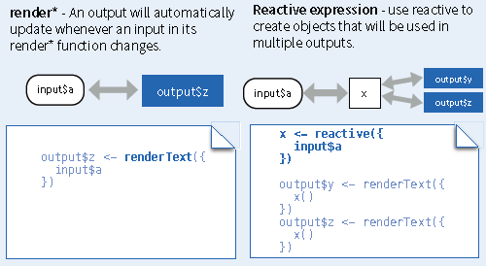
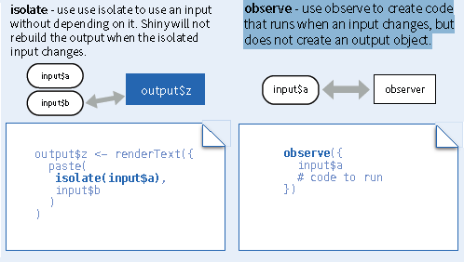
SHINY: Reactivity Example

Slide 33
SHINY: Pros and Cons
Advantage:
Shiny is not the best but the easiest choice for those who hate programming
Shiny provide free server to deploy which could help you to save money
Shiny provide static technique support for your project, you can get your question answered in Stack Overflow or Google discussion Group
Disadvantage:
Not flexible and enough secure if you use it as commercial Web Application
It’s very hard to respond and resolve the user request which will be very very easy if you use PHP, Java, or C#

Slide 34
Another Solutions for R to Web Application
Restful Solution: Something Like WebServices
OpenCPU is a system for embedded scientific computing and reproducible research. The OpenCPU server provides a reliable and interoperable HTTP API for data analysis based on R. You can either use the public servers or host your own.
Link:https://www.opencpu.org/
CGI Solution: use perl,python, ruby, java, c++, even php to dynamic execute R script
Pure JS Solution: R-NODE
Basic requirement:
Protovis – http://vis.stanford.edu/protovis/
Nodejs – http://nodejs.org/
R – http://www.r-project.org/
Rserve – http://www.rforge.net/Rserve/doc.html
Shjs – http://shjs.sourceforge.net/

Slide 35
Another Solutions for R to Web Application
Wt (pronounced as witty) is a C++ library for developing web applications.
“The API is widget-centric and uses well-tested patterns of desktop GUI development tailored to the web. To the developer, it offers abstraction of web-specific implementation details, including client-server protocols, event handling, graphics support, graceful degradation (or progressive enhancement), and URL handling.”
Link:http://www.webtoolkit.eu/wt

Slide 36
THANK YOU

Slide 37
REFERENCES
http://www.katrinerk.com/courses/r-worksheets/r-code-classification-with-naive-bayes
http://en.wikipedia.org/wiki/Decision_tree_learning
https://archive.ics.uci.edu/ml/datasets/Heart+Disease
http://www.researchgate.net/post/Can_anyone_suggest_a_data_set_for_heart_disease_prediction_processes
http://en.wikipedia.org/wiki/Naive_Bayes_classifier
http://www.dmmh.org
http://inpressco.com/wp-content/uploads/2014/02/Paper40220-224.pdf
HDPS: Heart Disease Prediction System - AH Chen, SY Huang, PS Hong, CH Cheng, EJ Lin, Department of Medical Informatics, Tzu Chi University, Hualien City, Taiwan
Data Mining Applications In Healthcare - TEPR 2004, May 21, 2004, V. “Juggy” Jagannathan, VP of Research, juggy@medquist.com
Data mining and its application and usage in medicine, Radhika

